Slide 1
Paraphrasing

Slide 2
Paraphrasing is most useful when quoting dense, abstract, archaic, or confusing material.
So…what does that mean?
Paraphrasing is taking something complicated and unclear and restating it in simpler, more understandable terms.

Slide 3
Why Paraphrase ?
Paraphrase a passage…
when you want your readers to understand all of its points
when you are unsure of its meaning. Rewording a complex writing into simple terms may help you better understand the content and purpose of the passage
when you want to avoid Plagiarism

Slide 4
Plagiarism
You’re plagiarizing if you...
take a paper from an Internet site, or writer, or any other source and pass it off as your own
Submit a paper that someone else has written, whether it was given to you, downloaded from the Internet, or copied from any other source.
Changed parts of an existing paper and claim the paper as your own.
All of the above
Answer: d
“the unauthorized or misleading use of language and text of another author.”

Slide 5
Ways to Avoid Plagiarism
When researching, be careful and methodical
while taking notes on content
when you paraphrase, quote, or summarize.
Practice using documentation
become comfortable with citing the sources you use (this includes MLA, APA, Chicago documentation styles).
https://owl.purdue.edu/owl/research_and_citation/apa_style/apa_formatting_and_style_guide/in_text_citations_the_basics.html

Slide 6
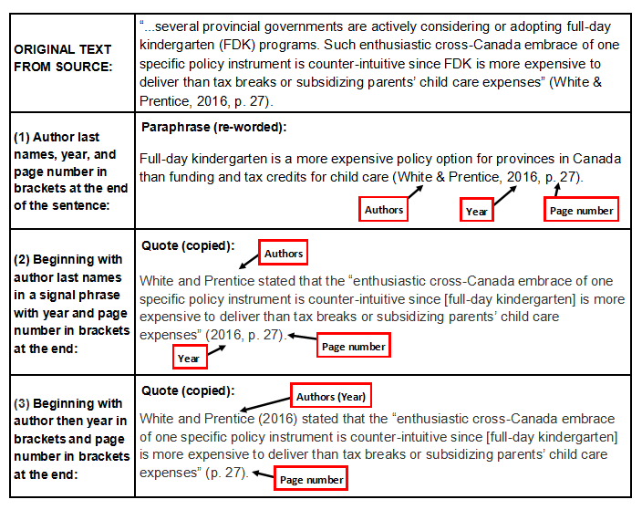

Slide 7
Paraphrasing How does a paraphrase differ from a summary?
The summary:
tells the main idea of a piece of writing.
is always shorter than the main text
eliminates details, examples, and supporting points.
always written in our own words.
is an abridged version of the original text.
A paraphrase:
takes the main idea and puts it into our own words.
both the words and the word order needs to be changed
the source is included in a citation
can be shorter or longer than the original text.
describes the original text in different words.
does not omit details.
What is a Bad Paraphrase?
Synonyms of certain words are substituted, while the structure of the original quotation is maintained.
For a good paraphrase, borrow only the idea conveyed by the author.
Express the sentiment in your own words, in your own way.

Slide 8
Below is a passage taken from Raymond S. Nickerson's "How We Know-and Sometimes Misjudge-What Others Know: Imputing One's Own Knowledge to Others.“ Psychological Bulletin 125.6 (1999): p737.
“In order to communicate effectively with other people, one must have a reasonably accurate idea of what they do and do not know that is pertinent to the communication. Treating people as though they have knowledge that they do not have can result in miscommunication and perhaps embarrassment. On the other hand, a fundamental rule of conversation, at least according to a Gricean view, is that one generally does not convey to others information that one can assume they already have.”
The author suggests that effective communication depends on a generally accurate knowledge of what the audience knows. If a speaker assumes too much knowledge about the subject, the audience will either misunderstand or be bewildered; however, assuming too little knowledge among those in the audience may cause them to feel patronized (Nickerson, 1999: 737).

Slide 9
Steps to Effective Paraphrasing.
Read over the text several times
Set the original text aside, and write your paraphrase
Use quotation marks to identify unique words or terminology borrowed directly from the original material.
check to make sure all necessary information in the original is included
Include reference or citations

Slide 10
Dos and Don’ts
Do Include all important ideas mentioned in the original passage.
Do Keep the length approximately the same as the original.
Do not stress any single point more than another.
Do not change the meaning by adding your own thoughts or views.
Do not use the original sentence structure or order.

Slide 11
Paraphrasing strategies
Use synonyms for all words that are not generic.
Words like world, food, or science are so basic to our vocabulary that is difficult to find a synonym.
Change the structure of the sentence.
Change the voice from active to passive and vice versa.
Change clauses to phrases and vice versa.
Change parts of speech.

Slide 12
changing sentence structure
Make a long sentence into two shorter ones.
Combine two short sentences and change their structure.
Simple Sentences: Complex Sentences: Compound Sentences
He confessed his illegal act.
He confessed that he was guilty of his illegal act.
Change the voice (from active to passive).
Suleiman changed the flat tire. (active) The flat tire was changed by Suleiman. (passive)
Change the order in which ideas are presented (as long as they still make sense in a different order).

Slide 13
Identify the important ideas in this passage:
---statements that seem complimentary in one context may be inappropriate in another. For example, women in business are usually uncomfortable if male colleagues or superiors compliment them on their appearance: the comments suggest that the women are being treated as visual decoration rather than as contributing workers. Locker, K. O. (2003). Business And Administrative Communication (6th Ed.). St. Louis, MO: Irwin/ Mcgraw-hill
appropriateness of statements is situational
working women may view compliments about appearance as offensive.
These compliments can be offensive because they may imply women are “decoration.”

Slide 14
Paraphrase A:
Words or expressions which appear favorable in one situation might be improper in a different situation. For instance, employed females are often uneasy when they are given positive comments on their looks. These remarks imply that the females are being viewed as adornment instead of as productive employees (Locker, 2003).
[Although this paraphrase does a good job of changing the wording, it is not effective for two main reasons. ]
it follows the sentence structure of the original passage too closely.
it fails to mention anything about "male colleagues or superiors." It also follows the same order or structure of ideas.

Slide 15
Paraphrase B:
Some statements may be inappropriate in one context, even though they are complimentary in another. Compliments by male colleagues or superiors regarding a female coworker’s appearance, for example, often make the woman feel uncomfortable. Instead of treating the women as contributing workers, men obviously think of them as visual decoration (Locker, 2003).
[While this paraphrase does a better job of changing the sentence structure, it also is ineffective.]
uses too many words from the original passage
changes the meaning "men obviously think of them as visual decoration.“
follows the same order or structure of ideas

Slide 16
Paraphrase C:
Women may feel uneasy upon receiving ordinarily positive comments on their appearance from male coworkers or supervisors. To these women, the remarks carry an implied meaning: instead of being thought of as productive employees, they are actually being viewed as just a pretty part of the environment. Depending on the situation, words or expressions which appear favorable may actually be unsuitable in a conversation (Locker, 2003).
This paraphrase is the most effective.
wording and sentence structure changed
all points included
meaning of the original passage retained
order of ideas changed

Slide 17
paraphrase the following passage:
“No historian should begin research with someone else’s notes. Taking notes is the first (and perhaps most important step) in developing our own interpretation of a subject. It forces us to decide (again and again) what is interesting and important” (Reuben, 2005, p. 413).
Reuben (2005) states that in order to develop an original analysis of their topic, historians must initiate research with their own “notes” rather than relying on someone else’s analysis.

Slide 18
paraphrase the following passage:
“According to our survey, 30 percent of students agreed that the university should offer a money-back guarantee if students fail to get the job they really want in their field because many students are finding themselves unemployed when they graduate” (Abrams,1975).
Abrams’ survey reveals that the lack of job placement for university graduates has caused some students to believe that their education should come with a money-back guarantee (1975).

Slide 19
paraphrase the following passage:
1610, Galileo Galilei published a small book describing astronomical observations that he had made of the skies above Padua. His homemade telescopes had less magnifying and resolving power than most beginners’ telescopes sold today, yet with them he made astonishing discoveries: that the moon has mountains and other topographical features; that Jupiter is orbited by satellites, which he called planets; and that the Milky Way is made up of individual stars. Source ( David Owen, “The Dark Side: Making War on Light Pollution,” The New Yorker (20, August 2007): 28.
Paraphrase
Galileo was able to make some amazing discoveries with his telescope. He made discoveries about the moon, about Jupiter, and about the Milky Way. He was able to do this with a telescope that was less powerful than even today's most basic telescopes. (Owen, 2007)

Slide 20
Sources
Avoiding Plagiarism
www.uis.edu
Learn to Paraphrase
https://www.uhv.edu/student-success-center/resources/e-p/learn-to-paraphrase/
General APA Guidelines
https://owl.english.purdue.edu/owl/resource/560/01/

Slide 21
Rubric
Criterion | Exceeds Expectations | Meets Expectations | Below Expectations
Points earned | 3 | 2 | 1
Main Idea | Main idea is clear | Main idea is hinted on | Main idea is incorrect
Detail | Relevant detail included | Some relevant detail missing | Too many or no details
Paraphrase | sentence and word order changed | Sentence put into own words | Sentence copied from text
Spelling /punctuation | No/or few spelling/ punctuation errors | some spelling/ punctuation errors | Many spelling/ punctuation errors
Grammar | Sentence structure is varied | Sentence structure is simple | No change in Sentence structure
References | Accurate use | Sufficient yet not always accurate use | Incorrect or missing references

